Slide 1
Graphing Quadratic and Polynomial Functions
Algebra 2
Chapter 2

Slide 2
This Slideshow was developed to accompany the textbook
  Big Ideas Algebra 2
  By Larson, R., Boswell
  2022 K12 (National Geographic/Cengage)
Some examples and diagrams are taken from the textbook.
Slides created by
Richard Wright, Andrews Academy
rwright@andrews.edu

Slide 3
2-01 Graph Quadratic Functions in Standard Form (2.1, 2.2)
Objectives:
Graph quadratic functions in standard form.
Apply transformations to quadratic functions.
Write a quadratic function in standard form given its graph.

Slide 4
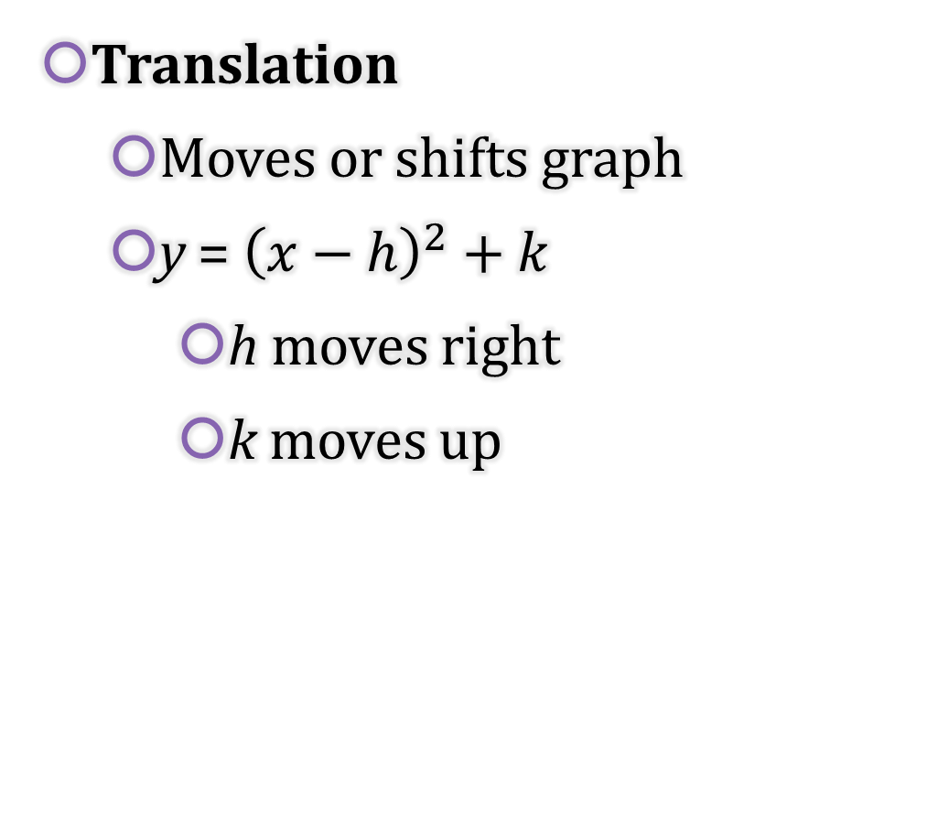
2-01 Graph Quadratic Functions in Standard Form (2.1, 2.2)
Translation
  Moves or shifts graph
  y = ${\left(x−h\right)}^{2}+k$
    h moves right
    k moves up

Slide 5

2-01 Graph Quadratic Functions in Standard Form (2.1, 2.2)
Reflection
  Flips graph over line
  $y=−\left(x^{2}\right)=−x^{2}$ reflects over x-axis
  $y={\left(−x\right)}^{2}=x^{2}$ reflects over y-axis

Slide 6

2-01 Graph Quadratic Functions in Standard Form (2.1, 2.2)
Stretch/Shrink
  Stretches or shrinks graph
  $y=ax^{2}$
    a vertical stretch

Slide 7


2-01 Graph Quadratic Functions in Standard Form (2.1, 2.2)
Describe the transformation of f(x) = x² represented by
$g(x)=(x−1)2+2$.
Describe the transformation of f(x) = x² represented by
$g\left(x\right)={\left(\frac{1}{4}x\right)}^{2}−2$
Notes:
The graph of g is a translation 1 unit right and 2 units up of the graph of f.
The graph of g is a horizontal stretch by a factor of 4, followed by a translation 2 units down of the graph of f.

Slide 8
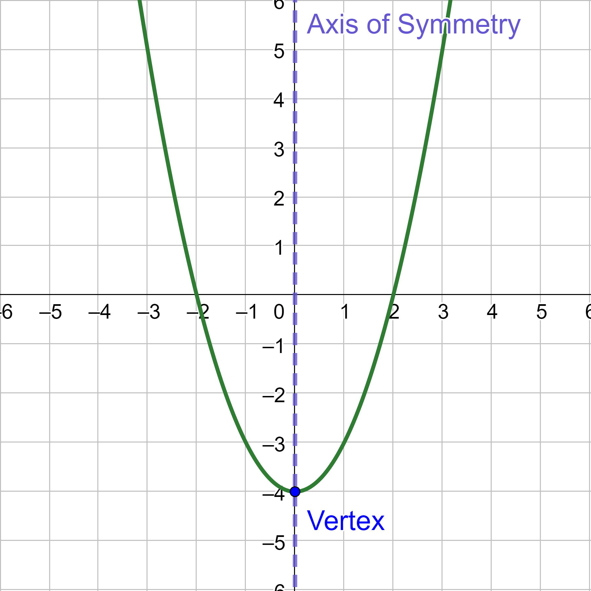
2-01 Graph Quadratic Functions in Standard Form (2.1, 2.2)
Properties of Quadratic Functions in Standard Form (Vertex Form)
f(x) = a(x − h)² + k
Vertex is (h, k).
Wideness of parabola
  If |a| > 1, then it looks narrower than y = x²
  If 0 < |a| < 1, then it looks wider than y = x²
Opens Up/Down
  If a > 0, the parabola opens up.
  If a < 0, the parabola opens down.

Slide 9
2-01 Graph Quadratic Functions in Standard Form (2.1, 2.2)
Graph a Quadratic Function
Find the vertex. In standard form, the vertex is (h, k).
Create a table of values with the vertex in the center.
Plot the points from the table of values. At least five points are required.
Draw a curve through the points.

Slide 10

2-01 Graph Quadratic Functions in Standard Form (2.1, 2.2)
Graph $f\left(x\right)=−x^{2}+3$
Notes:
Vertex (0, 3)
$$a=−1$$

Slide 11

2-01 Graph Quadratic Functions in Standard Form (2.1, 2.2)
Graph $f\left(x\right)=\frac{1}{2}{\left(x+1\right)}^{2}−2$
Notes:
Vertex (−1, −2)
$$a=\frac{1}{2}$$

Slide 12
2-01 Graph Quadratic Functions in Standard Form (2.1, 2.2)
Find a Quadratic Model
To find a quadratic model given vertex and another point,
Substitute the vertex into standard form, f(x) = a(x − h)² + k.
Substitute the other point for x and y.
Solve for a.
Write the quadratic function.

Slide 13
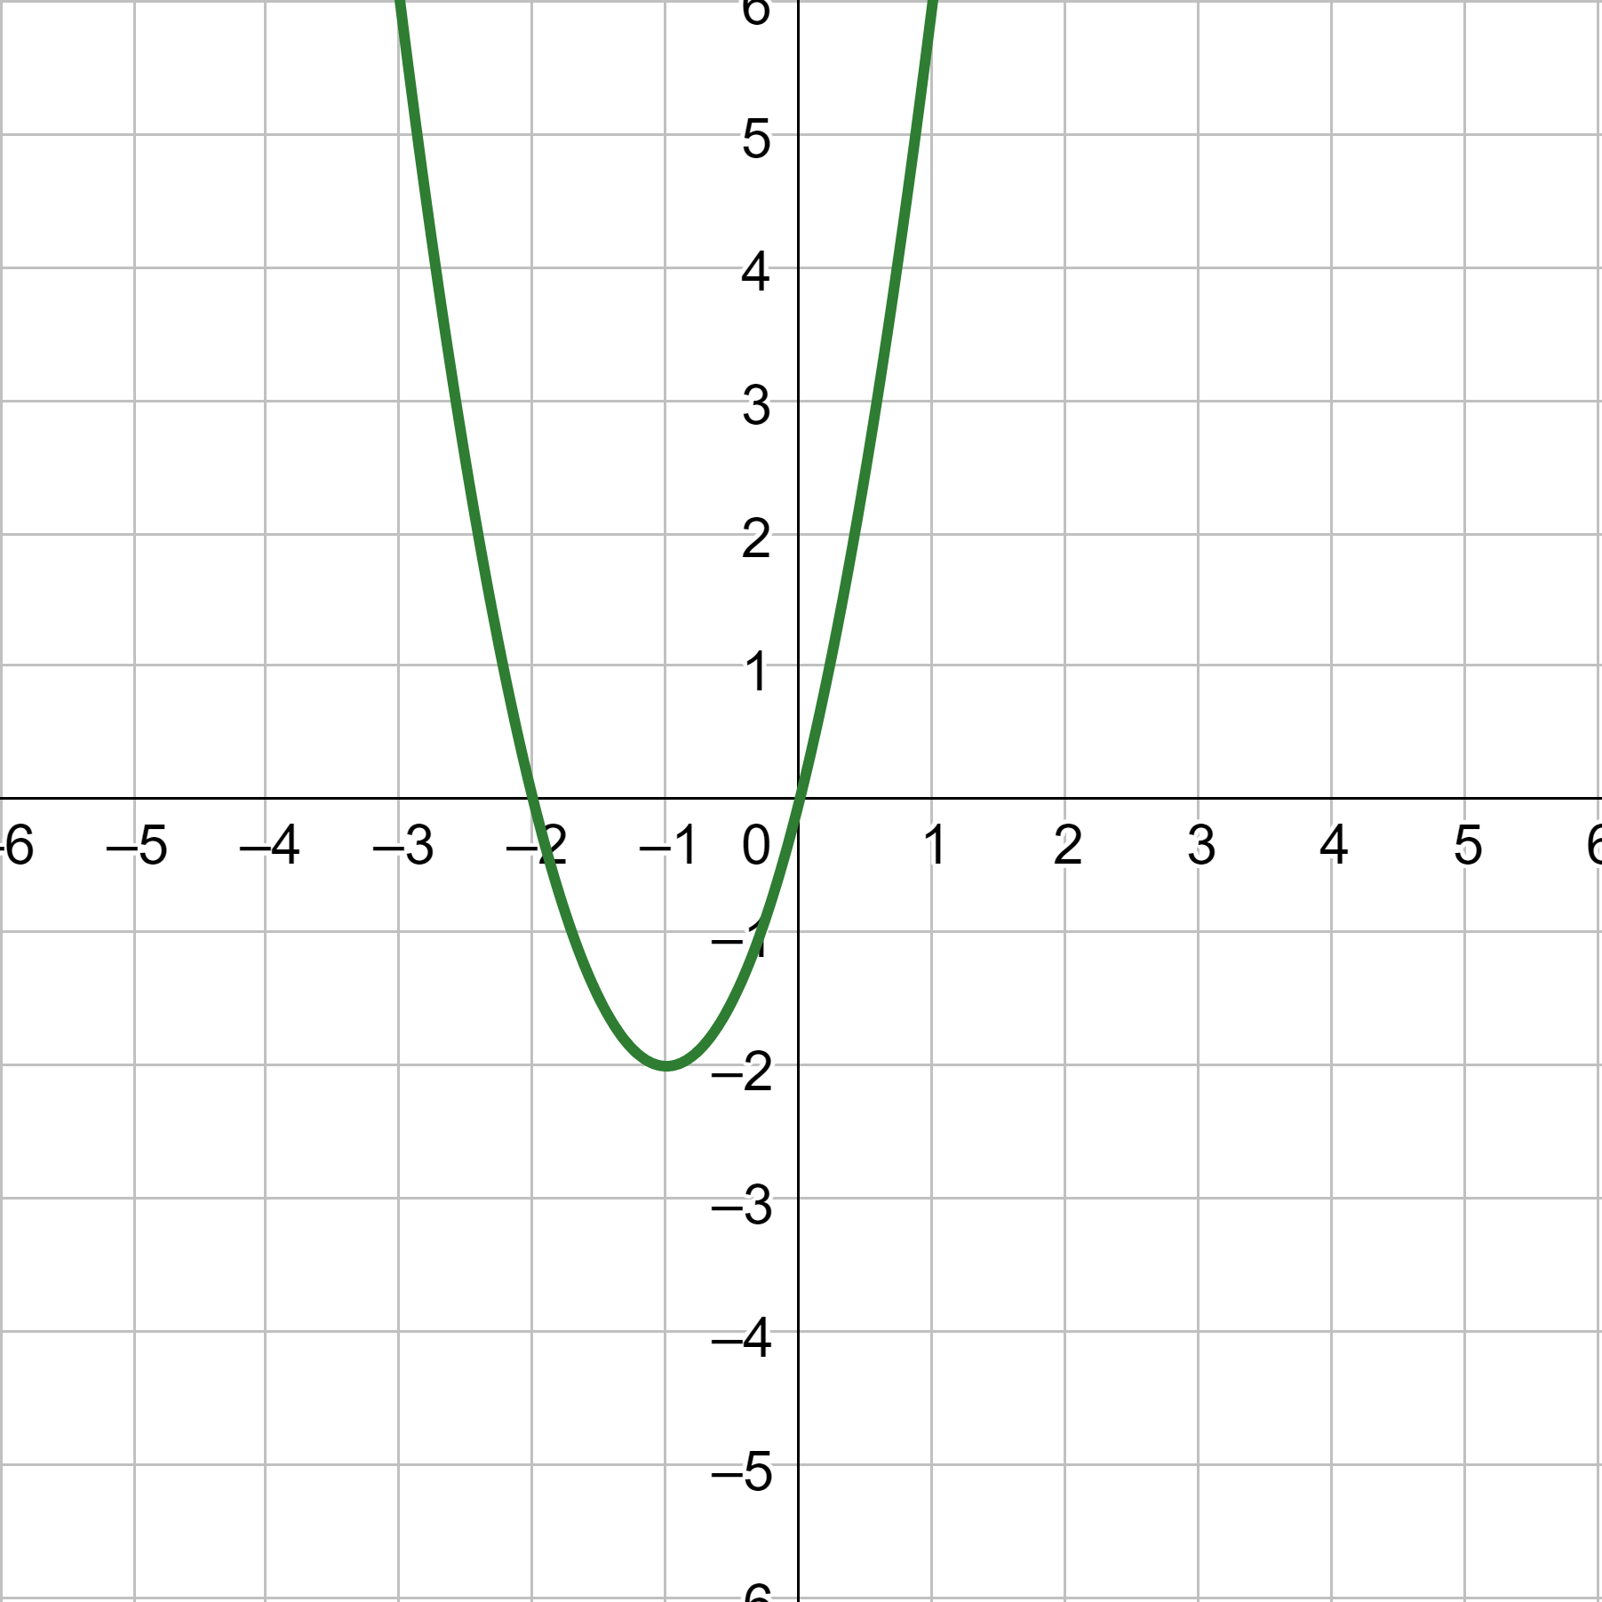
2-01 Graph Quadratic Functions in Standard Form (2.1, 2.2)
Write the quadratic function for the graph.
Notes:
Vertex at (−1, −2), so h = −1 and k = −2.
$$y=a{\left(x−h\right)}^{2}+k$$
$$y=a{\left(x+1\right)}^{2}−2$$
Plug in a point (0, 0).
$$0=a{\left(0+1\right)}^{2}−2$$
$$2=a$$
Write answer.
$$y=2{\left(x+1\right)}^{2}−2$$

Slide 14
2-02 Graph Quadratic Functions in General and Intercept Form (2.2)
Objectives:
Graph quadratic functions in intercept and general form.
Find the axis symmetry and vertex of a quadratic function.
Write a quadratic function in intercept form given its x-intercepts.

Slide 15
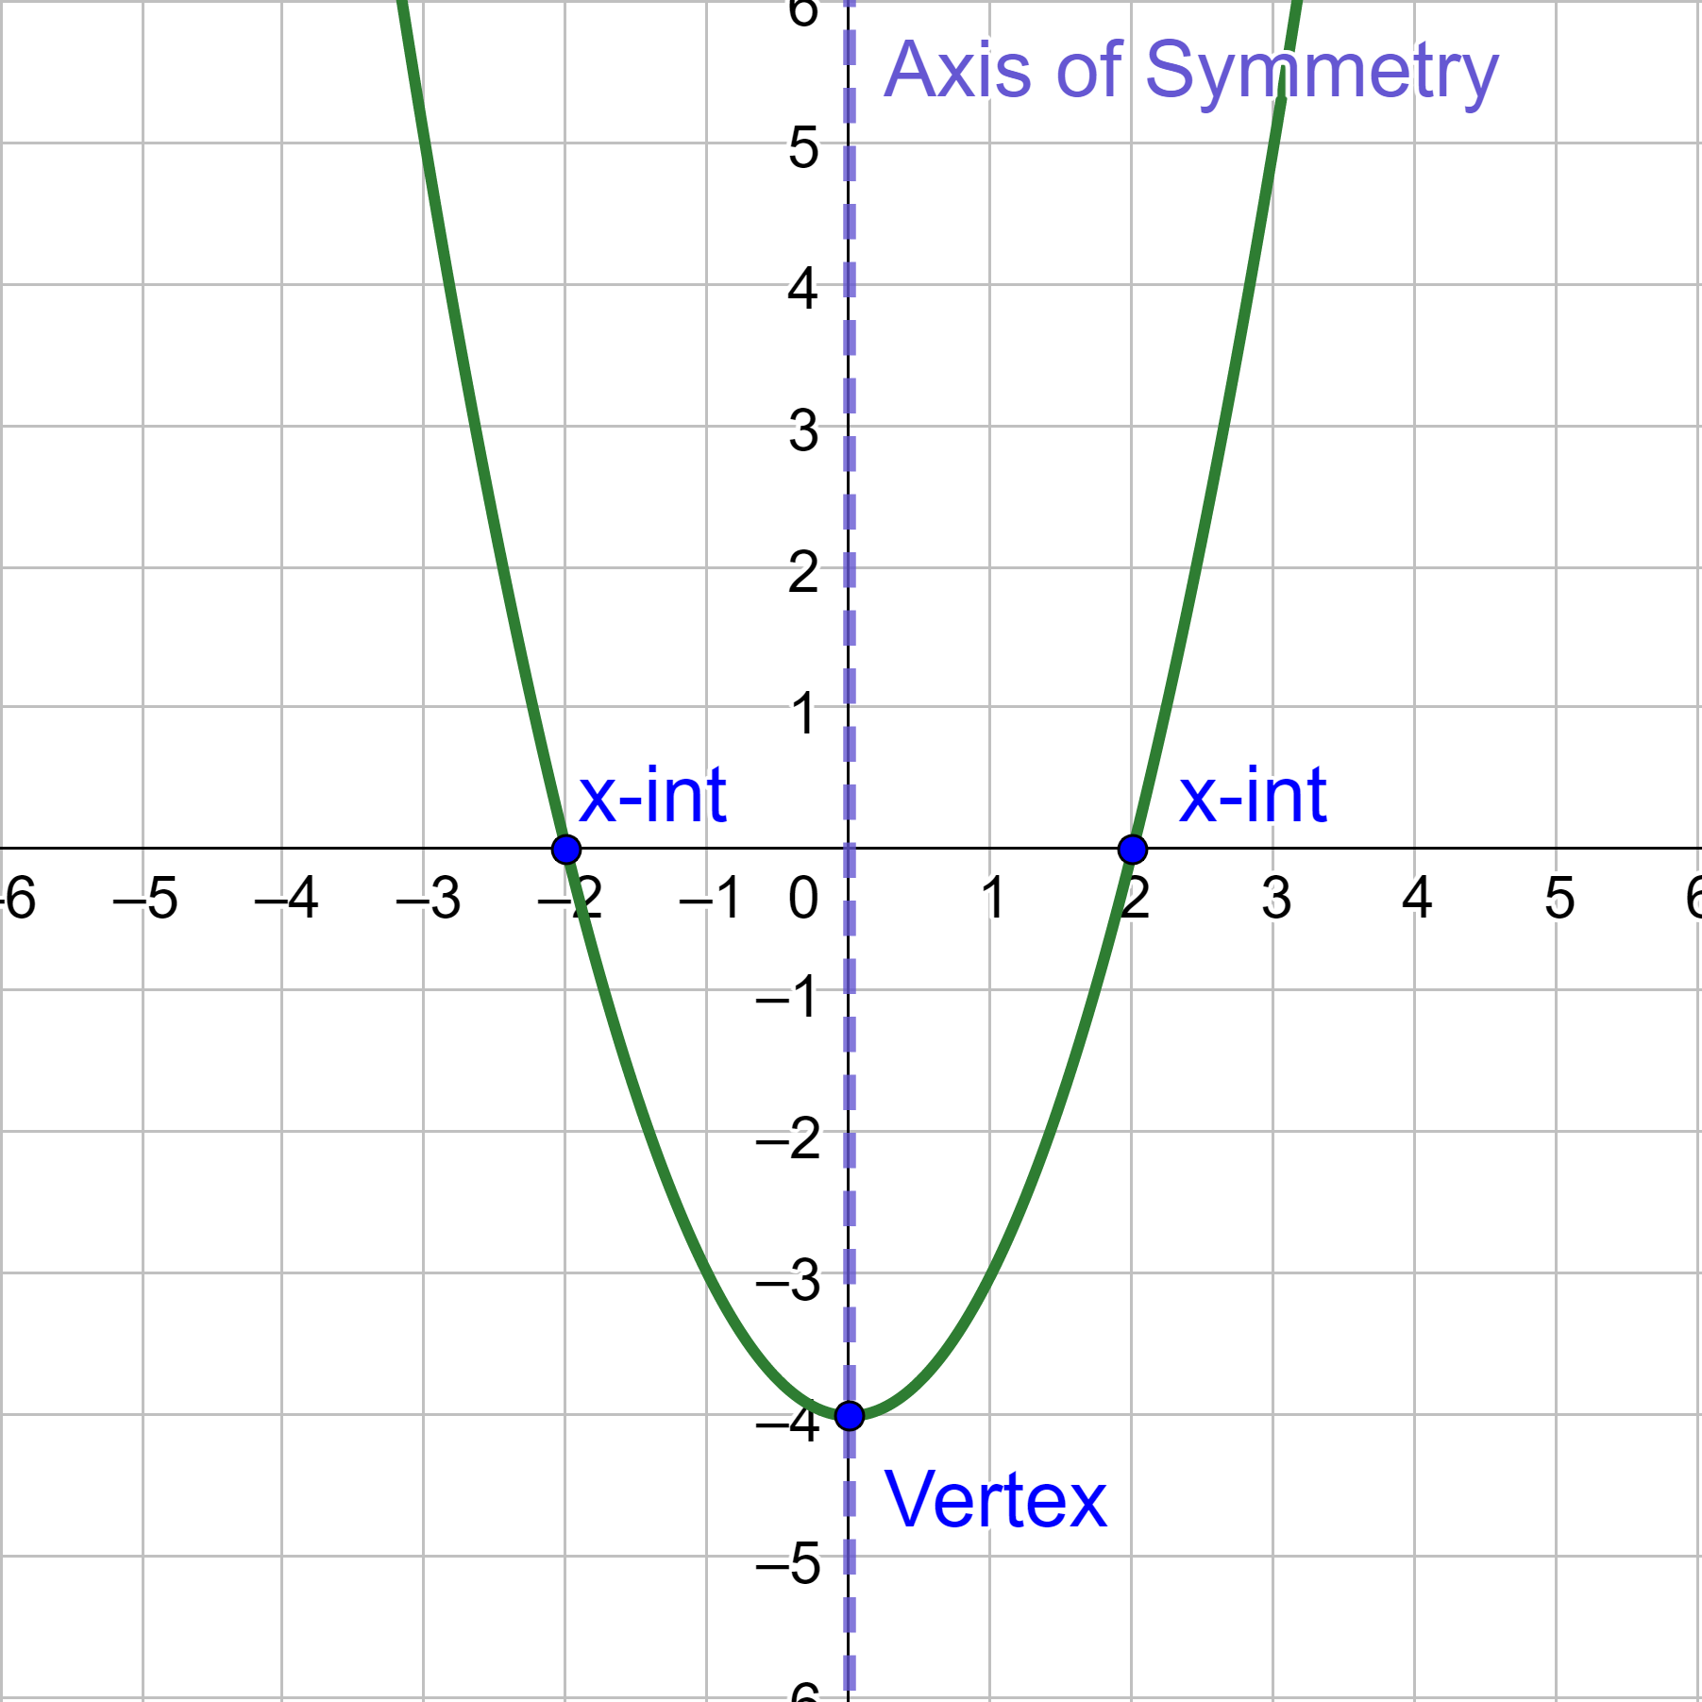
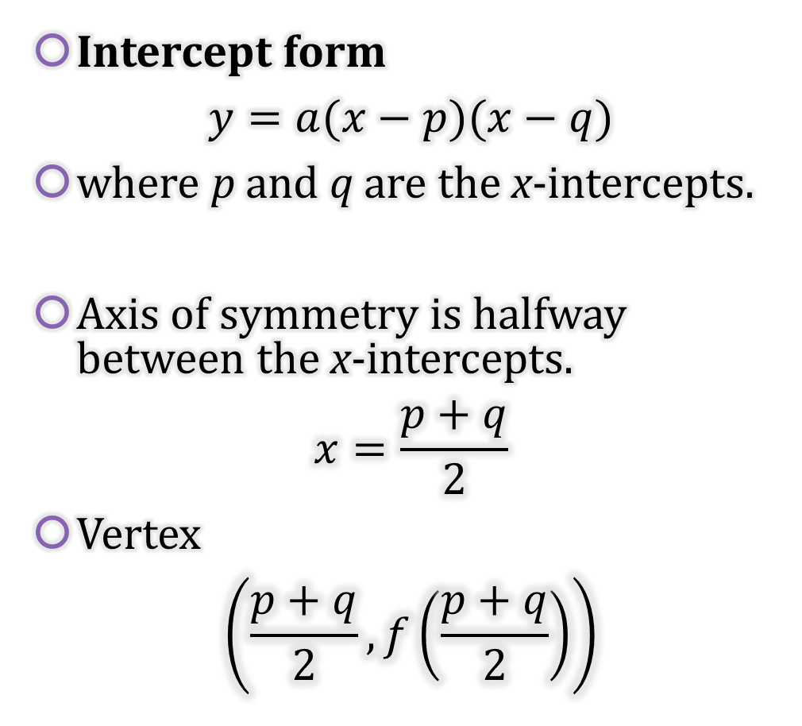
2-02 Graph Quadratic Functions in General and Intercept Form (2.2)
Intercept form
$$y=a(x−p)(x−q)$$
where p and q are the x-intercepts.
Axis of symmetry is halfway between the x-intercepts.
$$x=\frac{p+q}{2}$$
Vertex
$$\left(\frac{p+q}{2},f\left(\frac{p+q}{2}\right)\right)$$

Slide 16
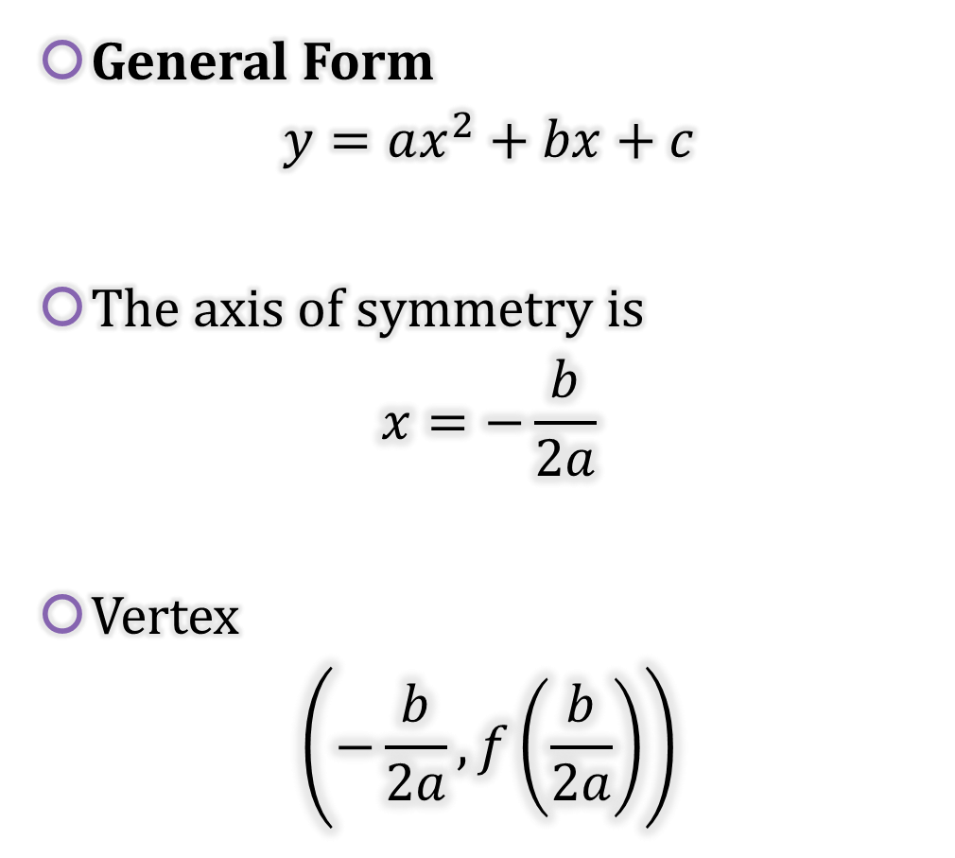
2-02 Graph Quadratic Functions in General and Intercept Form (2.2)
General Form
$$y=ax^{2}+bx+c$$
The axis of symmetry is
$$x=−\frac{b}{2a}$$
Vertex
$$\left(−\frac{b}{2a},f\left(\frac{b}{2a}\right)\right)$$

Slide 17
2-02 Graph Quadratic Functions in General and Intercept Form (2.2)
Graph a Quadratic Function
Find the axis of symmetry and vertex.
Make a table of values using points on either side of the axis of symmetry.
Plot the points from the table.
Draw the parabola through the points.

Slide 18

2-02 Graph Quadratic Functions in General and Intercept Form (2.2)
Graph $y=−2\left(x+2\right)\left(x−3\right)$
Notes:
p = −2 and q = 3
Axis of symmetry
$$x=\frac{p+q}{2}→x=\frac{−2+3}{2}→x=\frac{1}{2}$$
Vertex (plug in ½ to get y)
$$y=−2\left(\frac{1}{2}+2\right)\left(\frac{1}{2}−3\right)=\frac{25}{2}$$
$$\left(\frac{1}{2},\frac{25}{2}\right)$$
Make table and graph

Slide 19

2-02 Graph Quadratic Functions in General and Intercept Form (2.2)
Graph $y=x^{2}−2x−3$
Notes:
General form
a = 1, b = −2, c = −3
Axis of symmetry
$$x=\frac{−b}{2a}→x=\frac{−\left(−2\right)}{2(1)}→x=1$$
Vertex (plug in ½ to get y)
$$y={\left(1\right)}^{2}−2\left(1\right)−3=−4$$
$$\left(1,−4\right)$$
Make table and graph

Slide 20
2-02 Graph Quadratic Functions in General and Intercept Form (2.2)
Write a Quadratic Function in Intercept Form
Find the x-intercepts. These are p and q.
Find one other point that the graph passes through. This is (x, y).
Substitute the x-intercepts for p and q in intercept form y = a(x – p)(x – q).
Substitute the point for x and y.
Solve for a.
Write the function by substituting p, q, and a into intercept form.

Slide 21
2-02 Graph Quadratic Functions in General and Intercept Form (2.2)
Write the quadratic function whose x-intercepts are −3 and 7 and passes through (0, 21).
Notes:
p = −3 and q = 7
$$y=a\left(x−p\right)\left(x−q\right)$$
$$y=a\left(x+3\right)\left(x−7\right)$$
Plug in point
$$21=a\left(0+3\right)\left(0−7\right)$$
$$21=a\left(−21\right)$$
$$−1=a$$
Write equation
$$y=−\left(x+3\right)\left(x−7\right)$$

Slide 22
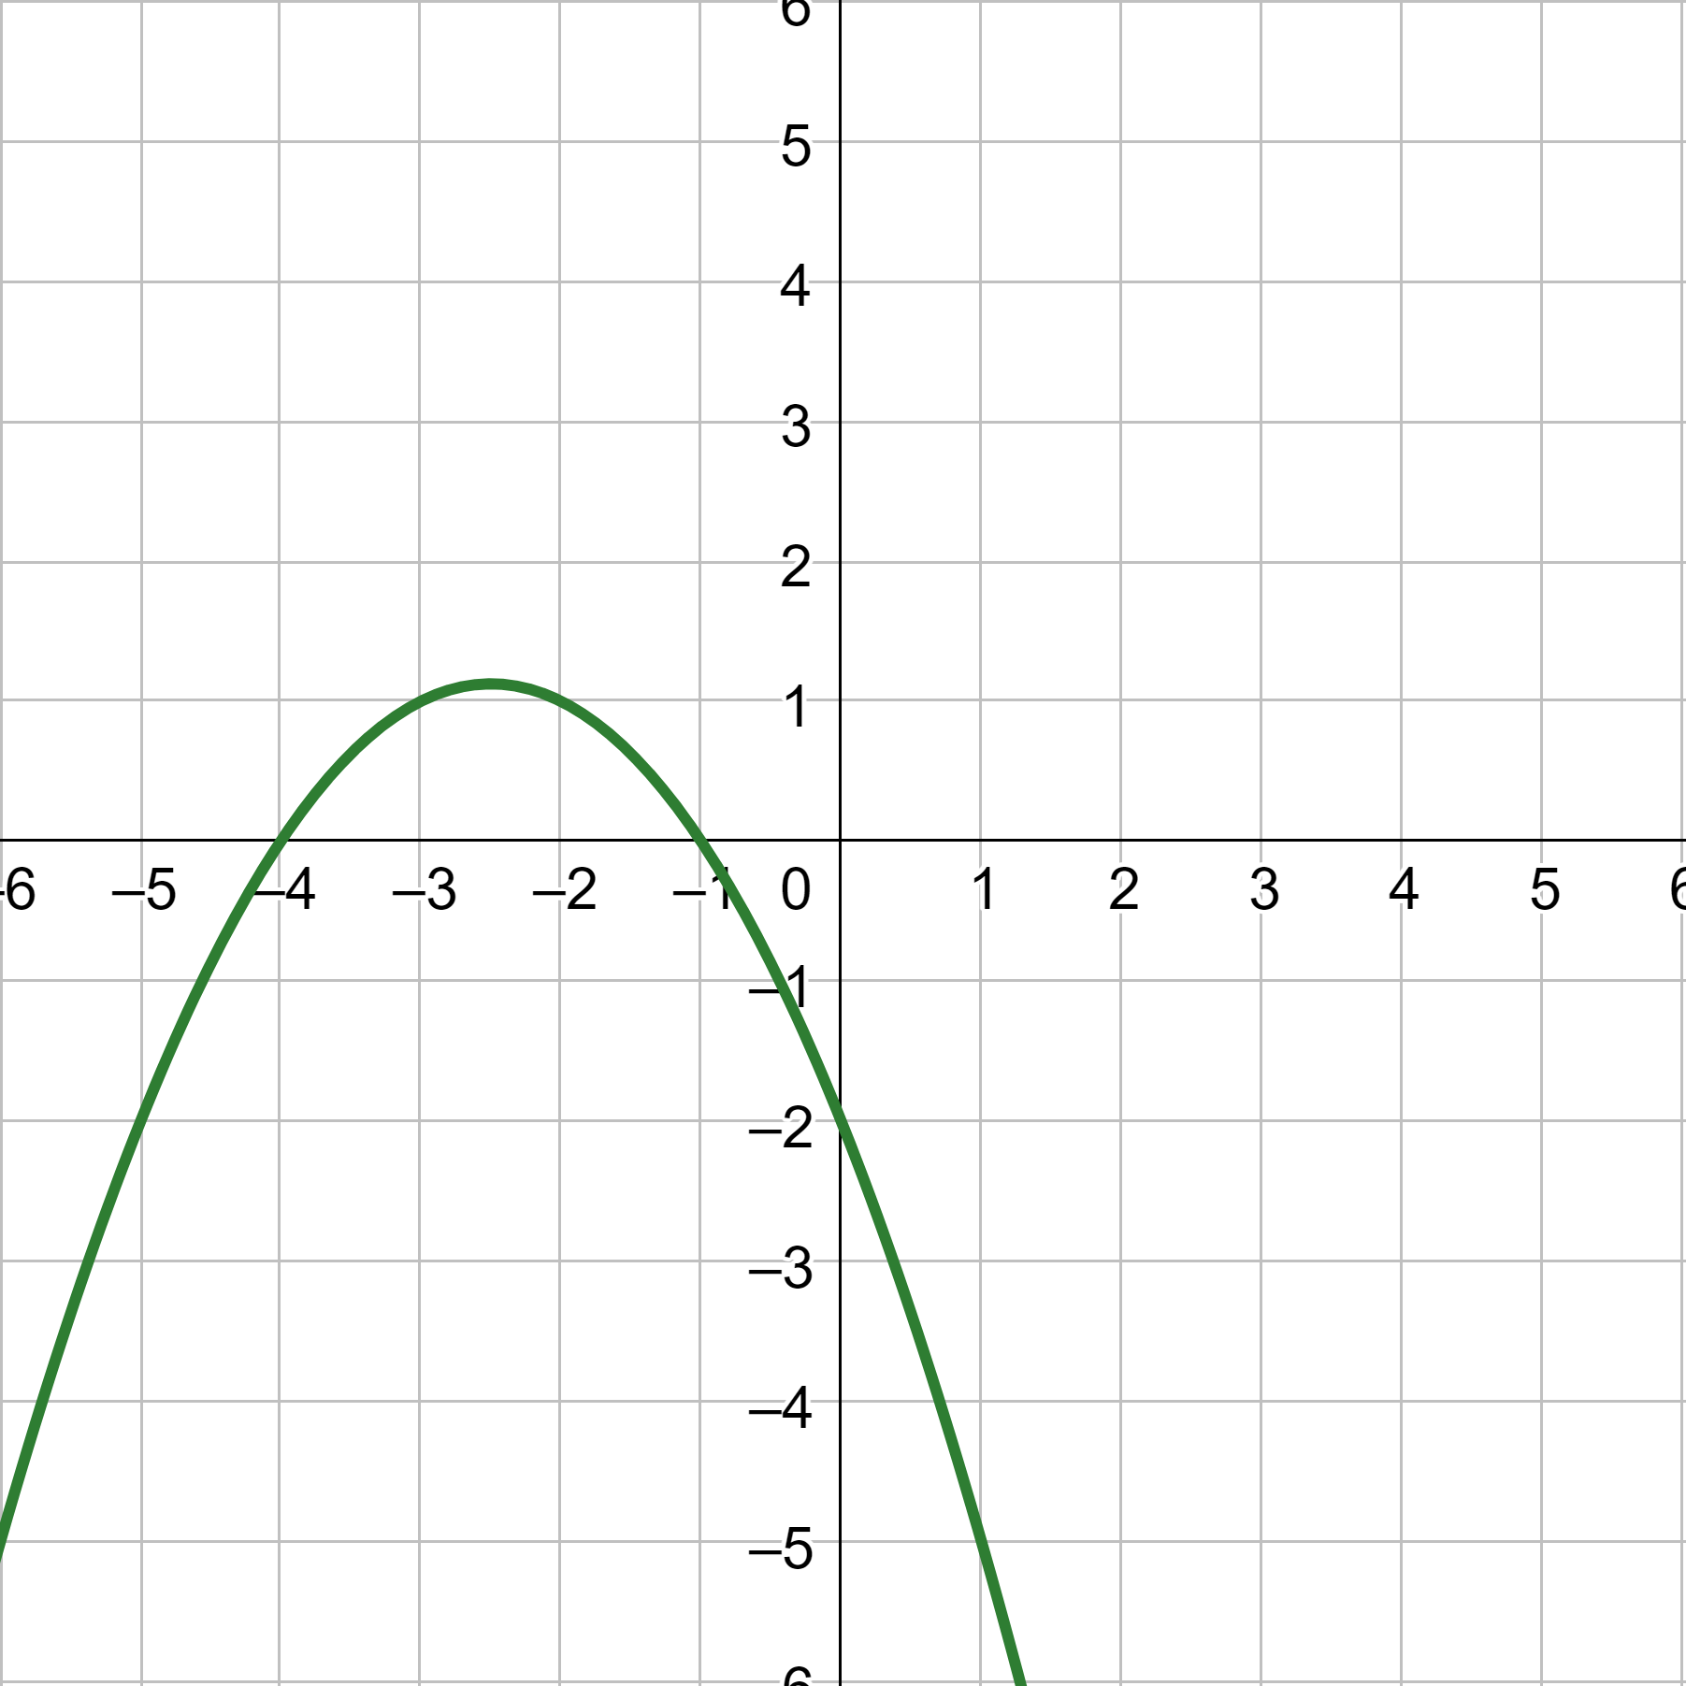
2-02 Graph Quadratic Functions in General and Intercept Form (2.2)
Write the quadratic function given in the graph.
Notes:
p = −4 and q = −1
Intercept form
$$y=a\left(x−p\right)\left(x−q\right)$$
$$y=a\left(x+4\right)\left(x+1\right)$$
Plug in a point (0, −2)
$$−2=a\left(0+4\right)\left(0+1\right)$$
$$−2=a\left(4\right)$$
$$a=−\frac{1}{2}$$
Write equation
$$y=−\frac{1}{2}\left(x+4\right)\left(x+1\right)$$

Slide 23
2-03 Graph Quadratic Inequalities (3.6)
Objectives:
Graph a quadratic inequality in two dimensions.
Graph a system of quadratic inequalities in two dimensions.

Slide 24
2-03 Graph Quadratic Inequalities (3.6)
Graph a Quadratic Inequality in Two Dimensions
Graph the inequality as if it was a function.
Decide whether the line is solid or dashed.
  ≤, =, ≥ → solid line.
  <, > → dashed line.
Decide where to shade.
  Method 1:
    Pick a test point not on the line and substitute it into the original inequality.
    If the point is a solution, shade that side of the parabola.
    If it is NOT a solution, shade the other side.
  Method 2:
    Solve the inequality for y.
    If the inequality is y >, shade above the parabola.
    If the inequality is y <, shade below.

Slide 25

2-03 Graph Quadratic Inequalities (3.6)
Graph $y≤\frac{1}{2}\left(x+2\right)\left(x−4\right)$
Notes:
x-intercepts −2, 4
Vertex at $x=\frac{−2+4}{2}=1$
Solid line
y ≤ 0, shade below

Slide 26

2-03 Graph Quadratic Inequalities (3.6)
Graph $y>2{\left(x−2\right)}^{2}−5$
Notes:
Vertex at (2, −5)
Dotted line
y > 0, shade above

Slide 27
2-03 Graph Quadratic Inequalities (3.6)
Graph a System of Quadratic Inequalities
Graph each inequality on the same coordinate plane.
The solution is all the points where all the shaded areas overlap.
If there is no overlap of the shaded areas, then there is no solution.

Slide 28
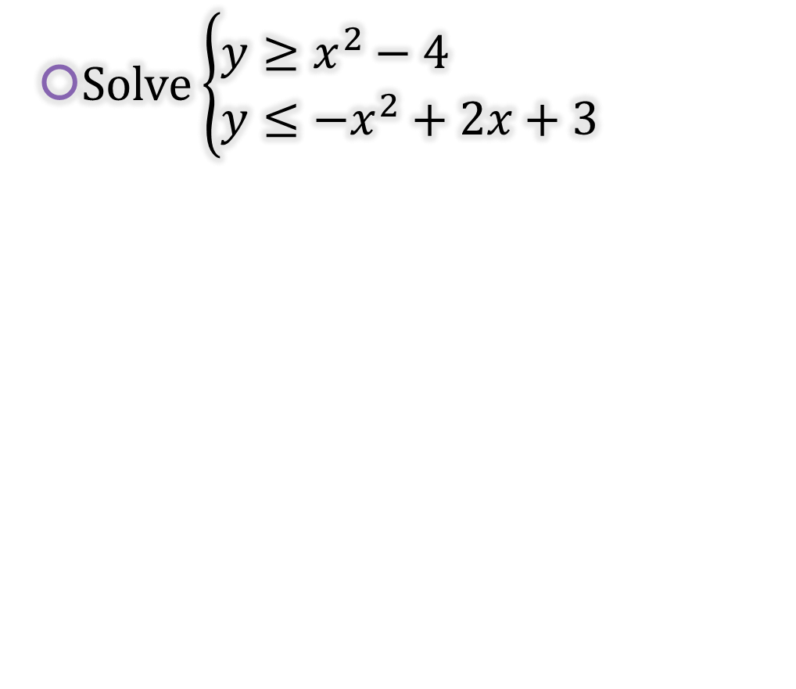
2-03 Graph Quadratic Inequalities (3.6)
Solve $\left\{\begin{aligned}y&≥x^{2}−4 \\ y&≤−x^{2}+2x+3\end{aligned}\right.$
Notes:
$$y≥x^{2}−4$$
Vertex at $x=−\frac{b}{2a}=−\frac{0}{2\left(1\right)}=0$
Solid line
y ≥ 0, shade above
$$y≤−x^{2}+2x+3$$
Vertex at $x=−\frac{b}{2a}=−\frac{2}{2\left(−1\right)}=1$
Solid line
y ≤ 0, shade below

Slide 29
2-04 Graph Polynomial Functions (4.1, 4.8)
Objectives:
Describe the end behavior of a polynomial functions.
Graph polynomial functions.
Find the turning points from a graph.
Find the x-intercepts from a graph.

Slide 30
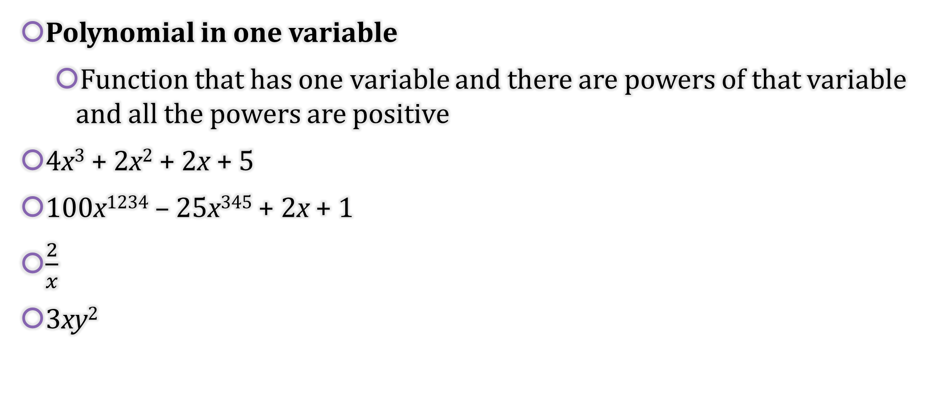
2-04 Graph Polynomial Functions (4.1, 4.8)
Polynomial in one variable
  Function that has one variable and there are powers of that variable and all the powers are positive
4x³ + 2x² + 2x + 5
100x¹²³⁴ – 25x³⁴⁵ + 2x + 1
$\frac{2}{x}$
3xy²
Not Polynomials in one variable.

Slide 31
2-04 Graph Polynomial Functions (4.1, 4.8)
Degree
  Highest power of the variable
What is the degree?
  4x³ + 2x² + 2x + 5
Notes:
3

Slide 32
2-04 Graph Polynomial Functions (4.1, 4.8)
Types of Polynomial Functions
Degree → Type
  0 → Constant → y = 2
  1 → Linear → y = 2x + 1
  2 → Quadratic → y = 2x² + x – 1
  3 → Cubic → y = 2x³ + x² + x – 1
  4 → Quartic → y = 2x⁴ + 2x² – 1

Slide 33
2-04 Graph Polynomial Functions (4.1, 4.8)
End Behavior
  Polynomial functions always go towards ∞ or -∞ at either end of the graph
 | Leading Coefficient + | Leading Coefficient -
Even Degree
Odd Degree
Notes:
(this is for even degree with positive first term)

Slide 34
2-04 Graph Polynomial Functions (4.1, 4.8)
Graphing polynomial functions
  Make a table of values
  Plot the points
  Make sure the graph matches the appropriate end behavior

Slide 35
2-04 Graph Polynomial Functions (4.1, 4.8)
Graph f(x) = x³ + 2x – 4
Notes:
Make table, points are (−3, −37), (−2, −16), (−1, −7), (0, −4), (1, −1), (2, 8), (3, 29)

Slide 36
2-04 Graph Polynomial Functions (4.1, 4.8)
x-intercepts
  Points where the graph crosses the x-axis
Turning Points
  Local Maximum and minimum (turn from going up to down or down to up)
  The graph of every polynomial function of degree n can have at most n−1 turning points.
  Calculus lets you find the turning points easily.

Slide 37
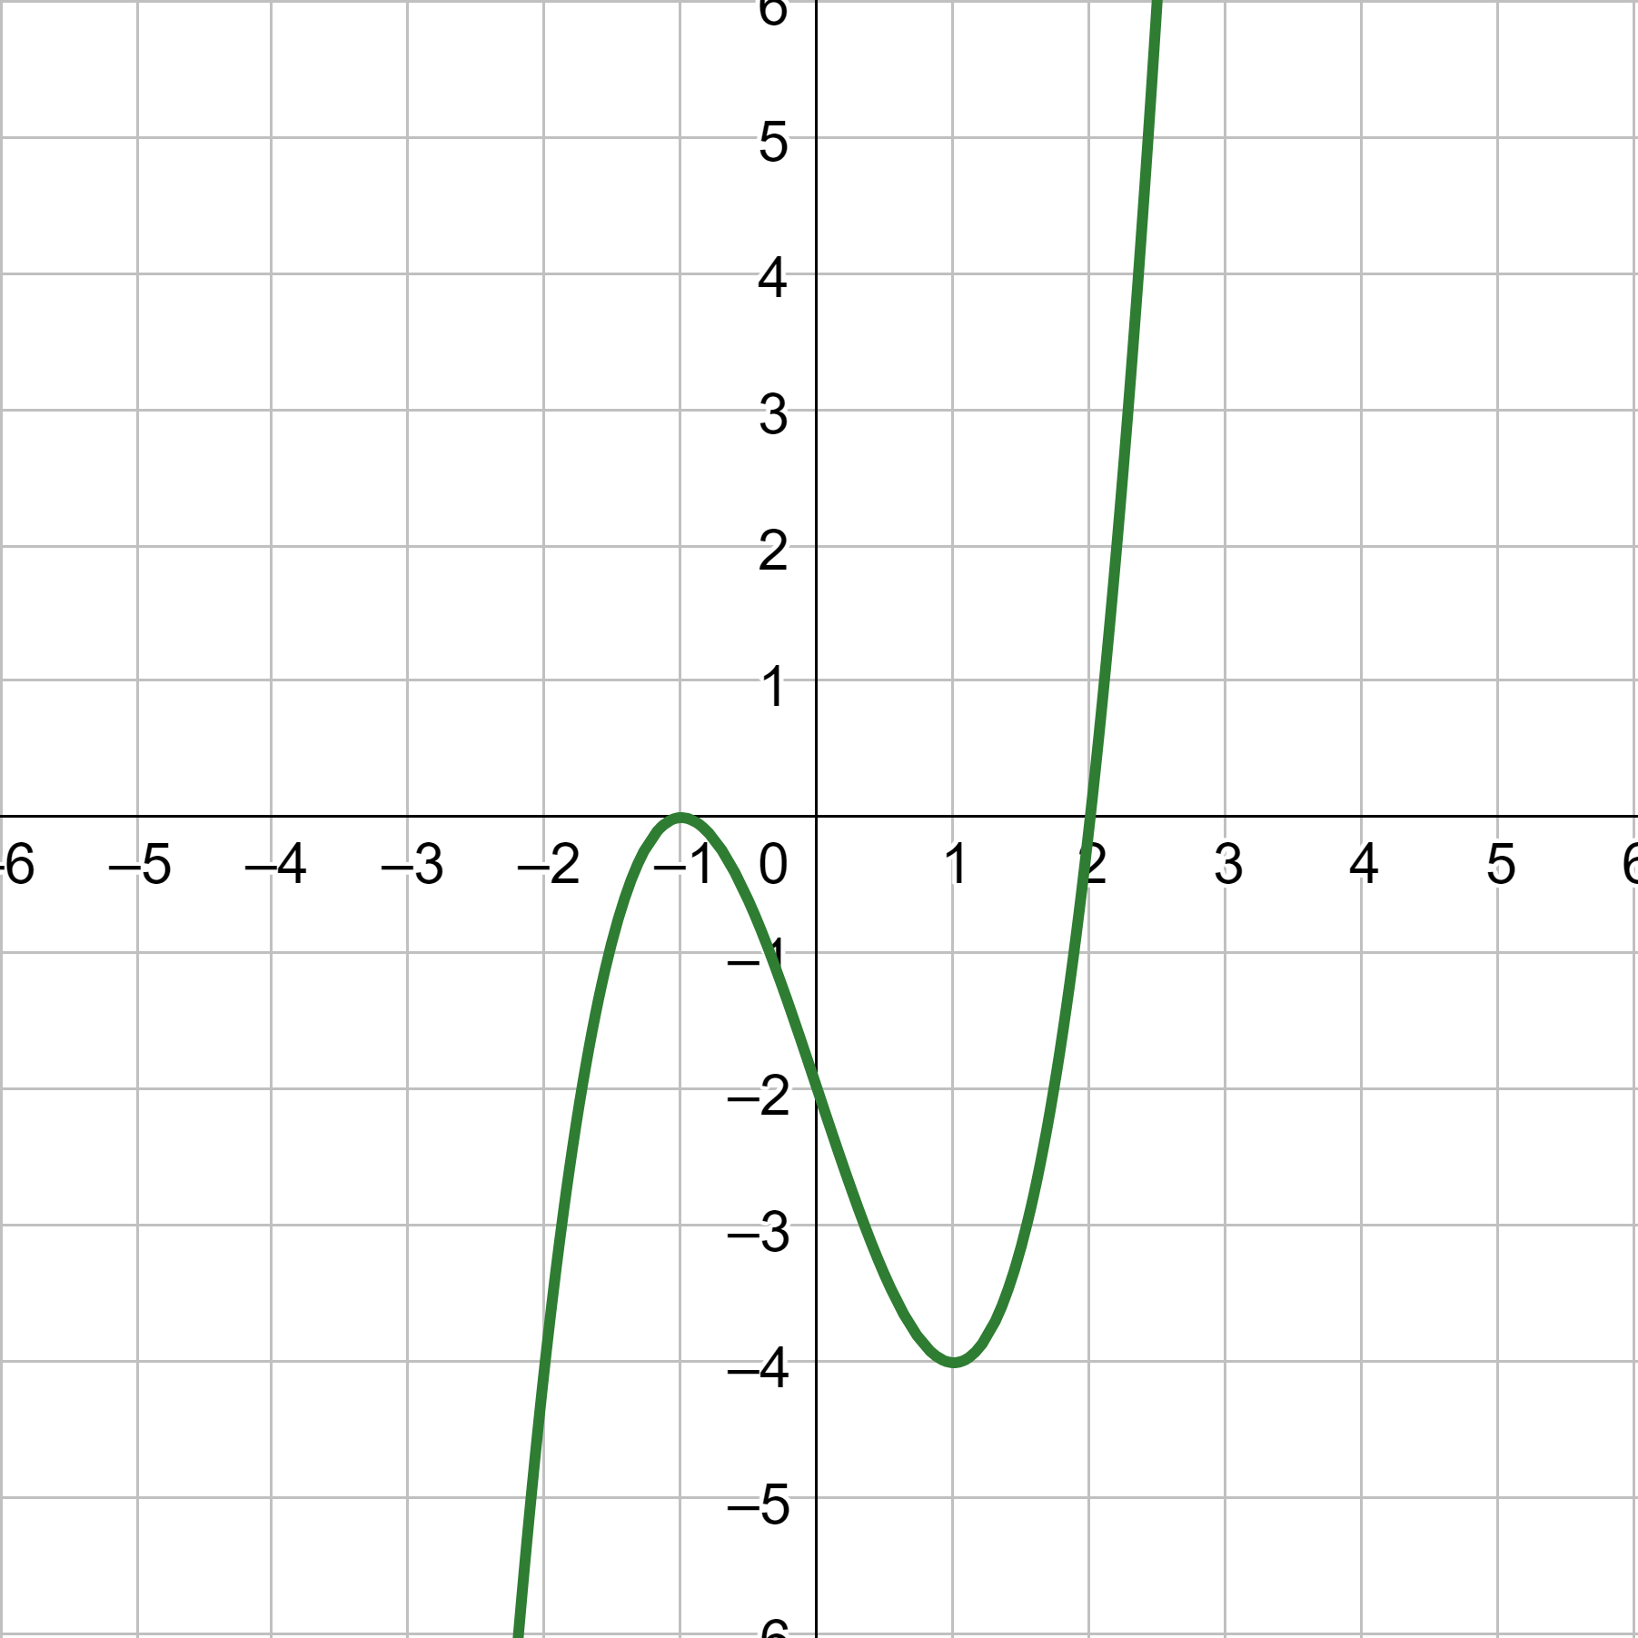
2-04 Graph Polynomial Functions (4.1, 4.8)
What are the x-intercepts and turning points?
Notes:
x-ints: (−1, 0), (2, 0)
Max: (−1, 0)
Min: (1, −4)

Slide 38
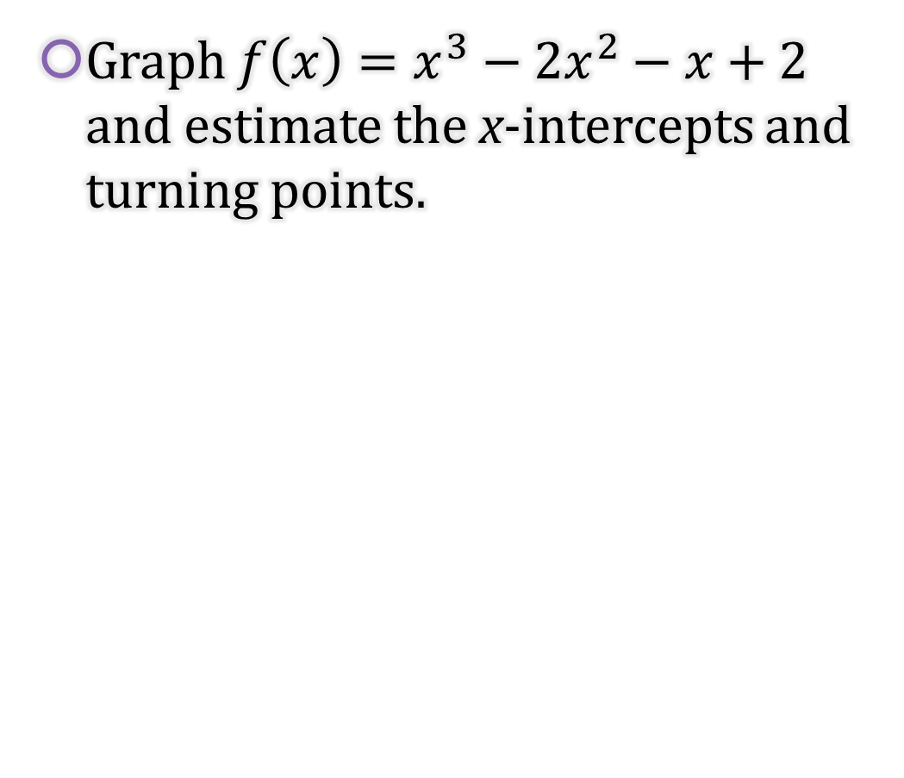
2-04 Graph Polynomial Functions (4.1, 4.8)
Graph $f\left(x\right)=x^{3}−2x^{2}−x+2$ and estimate the x-intercepts and turning points.
Notes:
x-ints: (−1, 0), (1, 0), (2, 0)
Max: (−0.22, 2.11)
Min: (1.55, −0.63)

Slide 39
2-05 Write Quadratic and Polynomial Models (4.9)
Objectives:
Write a polynomial model given the x-intercepts and one other point.
Write a polynomial model given points on the curve using finite differences and technology.
Write a best-fitting polynomial model for real-life situations using technology.

Slide 40
2-05 Write Quadratic and Polynomial Models (4.9)
Find a Polynomial Model Given x-intercepts
  Write a polynomial model in the form y = a(x – k₁)(x – k₂)(x – k₃)… where there is one factor per x-intercept.
  Substitute the x-intercepts for the k's.
  Substitute the other point for x and y.
  Solve for a.
  Write the polynomial function.

Slide 41
2-05 Write Quadratic and Polynomial Models (4.9)
Write a polynomial model with x-intercepts are −2, 1, 3 and (0, 2)
Notes:
$$y=a(x+2)(x−1)(x−3)$$
$$2=a(0+2)(0−1)(0−3) → 2=6a → a=\frac{1}{3}$$
$$y=\frac{1}{3}(x+2)(x−1)(x−3)$$

Slide 42
2-05 Write Quadratic and Polynomial Models (4.9)
Find the Degree of a Polynomial Using Finite Differences
Have a table of values with equally spaces x-values.
Find the differences of successive y-values.
Find the differences of successive differences from the previous step.
Repeat until all the differences in a step are the same number (not zero).
The number of levels of differences is the degree of the function.

Slide 43
2-05 Write Quadratic and Polynomial Models (4.9)
Find the degree of the polynomial passing through (0, 1), (1, 6), (2, 25), (3, 70), (4, 153), (5, 286)
Notes:
x 0 1 2 3 4 5
y 1 6 25 70 153 286
\ / \ / \ / \ / \ /
5 19 45 83 133
\ / \ / \ / \ /
14 26 38 50
\ / \ / \ /
12 12 12
Third order differences, so degree 3

Slide 44
2-05 Write Quadratic and Polynomial Models (4.9)
Finding a model given several points
Use finite difference to find the degree.
Use either of the following methods.
Method 1: Solve a System of Equations by Hand (This lesson uses Method 2)
Write a general polynomial function of the given degree such as y = ax³ + bx² + cx + d.
Substitute a point for x and y to get an equation where the variables are the coefficients.
Substitute another point in the general polynomial for x and y to get a second equation where the variables are the coefficients.
Continue substituting points until there the same number of equations as coefficients.
Solve the system of equations using something like elimination to find the values of the coefficients.
Write the equation by substituting the coefficients into the general polynomial.
Method 2: Use a Regression on a Graphing Calculator

Slide 45
2-05 Write Quadratic and Polynomial Models (4.9)
Finding Linear Regression on a TI-84
Push STAT and select Edit….
Enter the x-values in List 1 (L1) and the y-values in List 2 (L2).
To see the graph of the points
  Push Y= and clear any equations.
  While still in Y=, go up and highlight Plot1 and press ENTER.
  Press ZOOM and select ZoomStat.
Push STAT and move over to the CALC menu.
Select the type of regression.
Make sure the Xlist: is L1, the Ylist: is L2, the FreqList: is blank, and the Store RegEQ: is Y1.
  Get Y1 by pressing VARS and select Y-VARS menu.
  Select Function….
  Select Y1.
Press Calculate
The calculator will display the equation. To see the graph of the points and line, press GRAPH.
Notes:
Note: Older TI graphing calculators do not have the screen in steps 6 and 7. After selecting the LinReg(ax+b), the screen just shows "LinReg(ax+b)". Press ENTER again to see the result. To see the graph, enter the equation into the Y= screen and press GRAPH.

Slide 46
2-05 Write Quadratic and Polynomial Models (4.9)
Finding Linear Regression on a NumWorks graphing calculator
On the home screen select Regression.
In the Data tab, enter the points.
Move to the Graph tab.
The default is a linear regression and is displayed at the bottom of the screen. To change the regression type
  Press OK.
  Select Regression.
  Select the desired regression type.

Slide 47
2-05 Write Quadratic and Polynomial Models (4.9)
Find a polynomial function passing through
(1, −2), (2, 2), (3, 12), (4, 28), (5, 50), (6, 78)
Notes:
Find finite differences
x 1 2 3 4 5 6
y −2 2 12 28 50 78
\ / \ / \ / \ / \ /
4 10 16 22 28
\ / \ / \ / \ /
6 6 6 6
Second order differences so degree = 2
Use a calculator or do by hand
$$f(x)=ax^{2}+bx+c$$
$$−2=a{\left(1\right)}^{2}+b(1)+c$$
$$2=a{\left(2\right)}^{2}+b(2)+c$$
$$12=a{\left(3\right)}^{2}+b(3)+c$$
$$f\left(x\right)=3x^{2}−5x$$

Slide 48
2-05 Write Quadratic and Polynomial Models (4.9)
Best-Fitting Polynomial Models
Real-life usually doesn’t fit a model exactly, so finite differences don’t work.
Use a calculator find regressions of several degrees.
Choose the one that seems to fit the data the best as shown on the graph.

